Slide 1
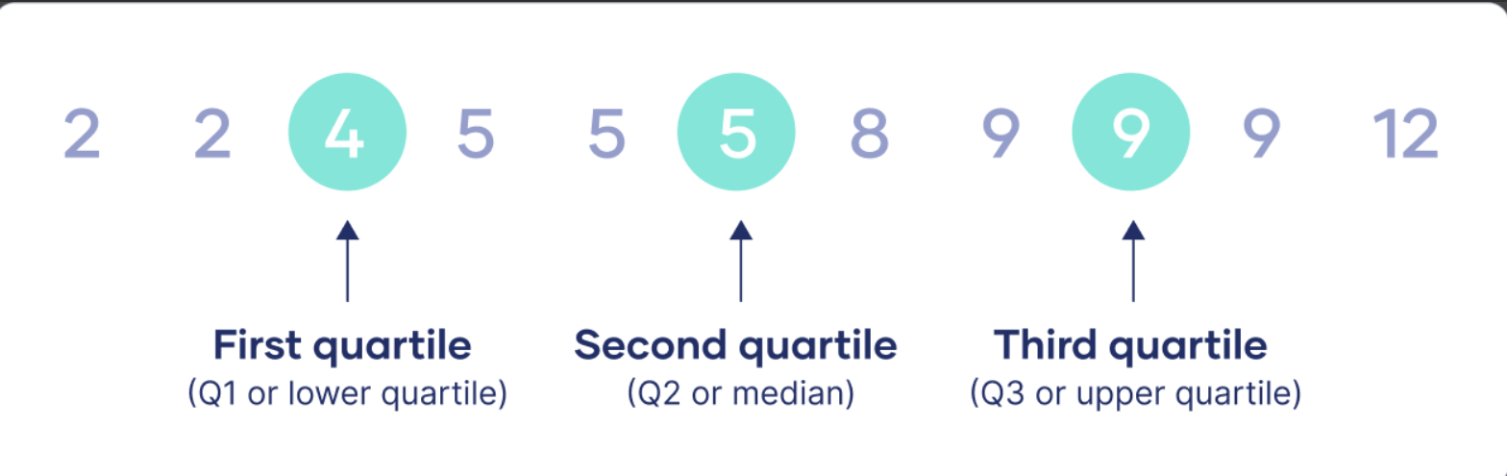
Quartiles The three distribution that divide the data into four equal parts. These values are called Q1, Q2 and Q3. Q1 is called the first and lower Quartile while Q3 is called the lower and 3rd Quartile. The Quartile are the values below which 25%. 50% and 70% of the data lie.

Slide 2
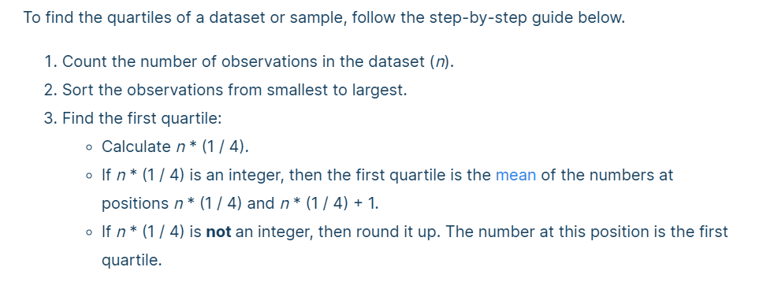
1st Quartile

Slide 3
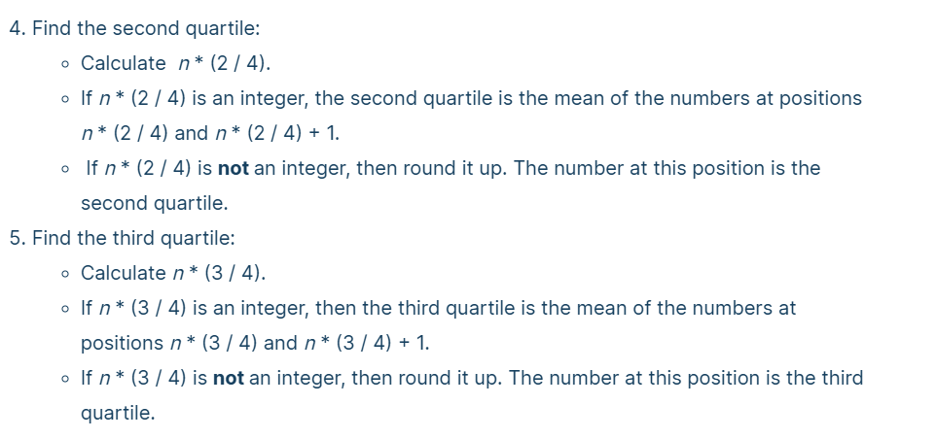
2nd and 3rd Quartile

Slide 4
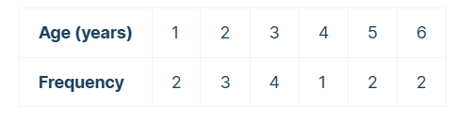
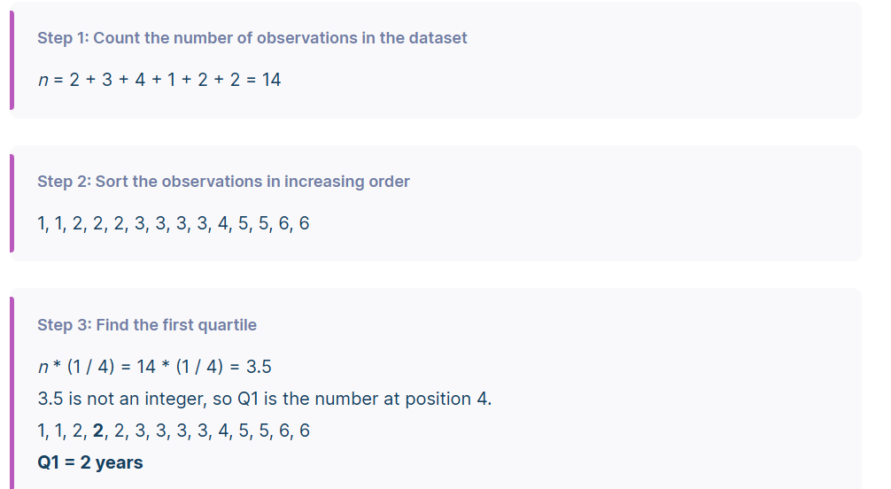

Slide 5
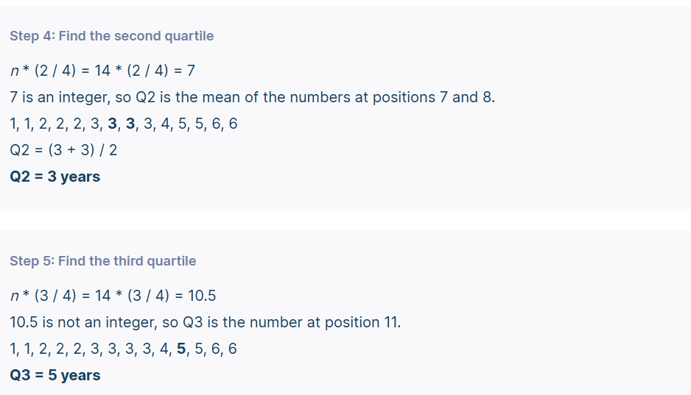

Slide 6
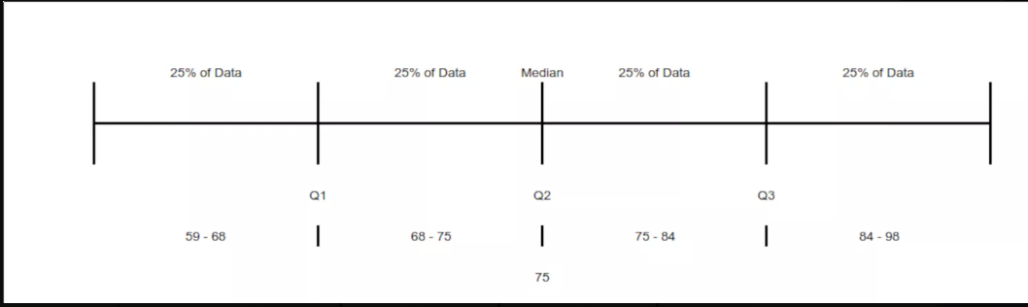
Find the Quartiles for the following data set:
59, 60, 65, 65, 68, 69, 70, 72, 75, 75, 76, 77, 81, 82, 84, 87, 90, 95, 98
First Quartile (Q1) = 20 x 1/4 = 5
Second Quartile (Q2) = 20 x 2/4 = 10
Third Quartile (Q3) = 20 x 3/4 = 15
Here, we have the Q1 (fifth) value of 68, the Q2 (tenth and the median) value of 75, and the Q3 (fifteenth) value of 84.

Slide 7
Quartile 1 (Q1) = (4+4)/2 = 4 Quartile 2 (Q2) = (10+11)/2 = 10.5 Quartile 3 (Q3) = (14+16)/2 = 15
Find the Quartiles for the following data set:
4, 17, 7, 14, 18, 12, 3, 16, 10, 4, 4, 11
Find lower quartile, upper quartile, and interquartile range of the following data set of values: 20, 19, 21, 22, 23, 24, 25, 27, 26
Median(Q2) = 5th Term = 23
Lower Quartile (Q1) = Mean of 2nd and 3rd term = (20 + 21)/2 = 20.5
Upper Quartile(Q3) = Mean of 7th and 8th term = (25 + 26)/2 = 25.5

Slide 8
Descriptive Statistics

Slide 9
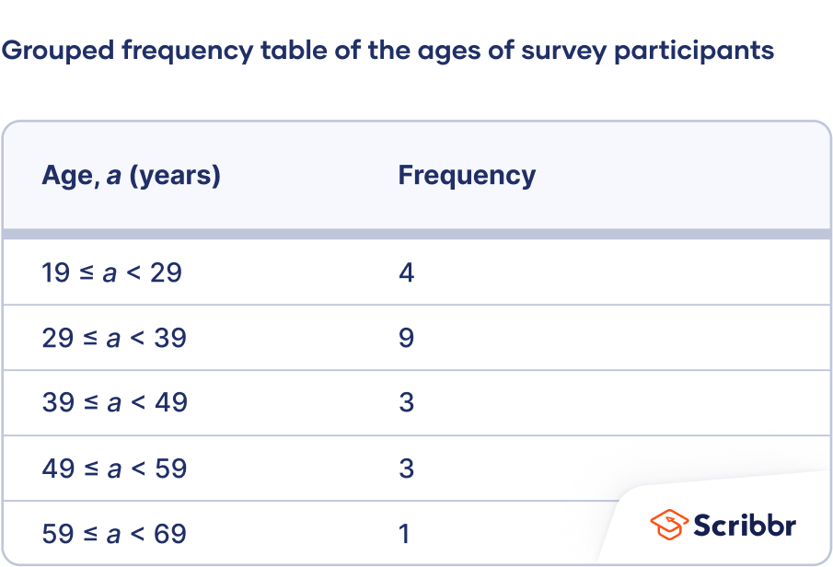
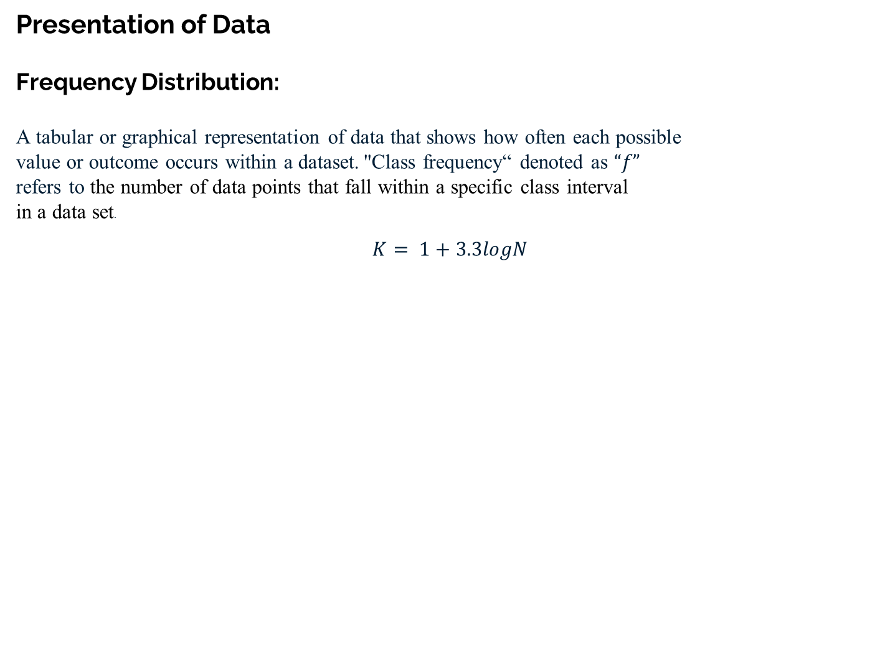
Presentation of Data Frequency Distribution: A tabular or graphical representation of data that shows how often each possible value or outcome occurs within a dataset. "Class frequency“ denoted as $“f”$ refers to the number of data points that fall within a specific class interval in a data set. $$K= 1+3.3logN$$

Slide 10
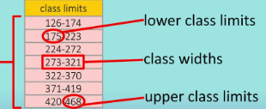
Class Limits: A class limits" refer to the lowest and highest values that define a specific class interval within a data set, with the lower value being called the "lower class limit" and the higher value being called the "upper class limit" of that class.

Slide 11
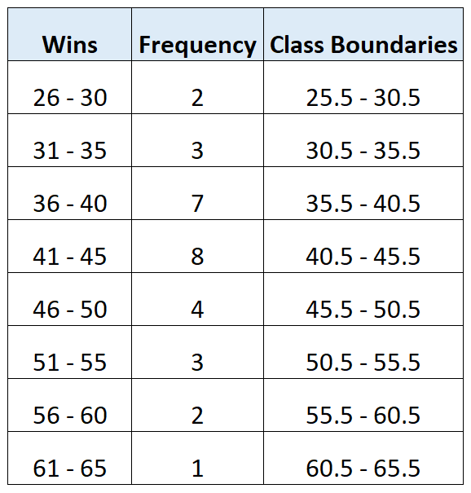
Class boundaries: A class boundary refers to the dividing line between two adjacent classes or categories in a dataset.

Slide 12
Class Width: A Class width represents the size of each class in a grouped frequency distribution.

Slide 13

Make a grouped frequency distribution from the following data, relating to the weight
recorded to the nearest grams of 60 apples picked out at random from a consignment,
106 107 76 82 109 107 115 93 187 95 123 125 111 92 86 70 126 68 130 129 139 119 115 128
100 186 84 99 113 204 111 141 136 123 90 115 98 110 78 185 162 178 140 152 173 146 158 194 148 90 107 181, 131, 75 184 104 110 80
By scanning the data, we find that the largest weight is 204 and the smallest weight is
grams 68 that the range is $204 — 68 = 136$grams,
$$Class width=\frac{136}{7}=19.47$$
$$h=20$$
Lower class limit = 65

Slide 14
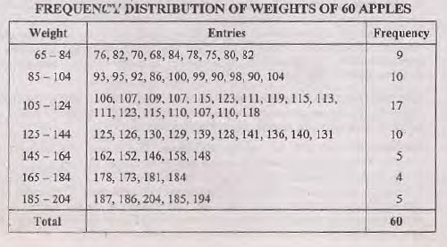

Slide 15
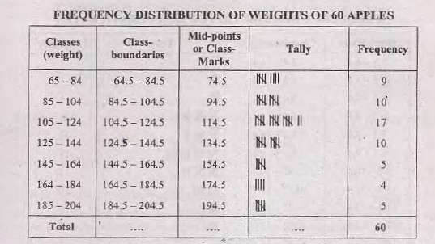

Slide 16
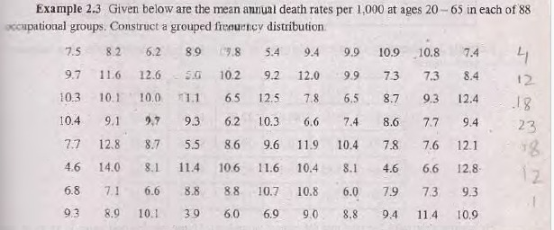

Slide 17
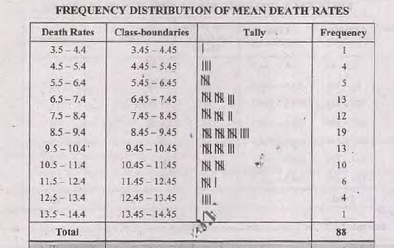

Slide 18
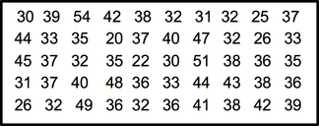
Example Consider the following raw data

Slide 19
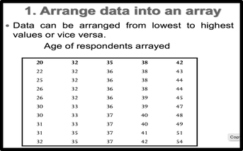

Slide 20
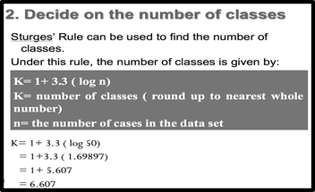

Slide 21
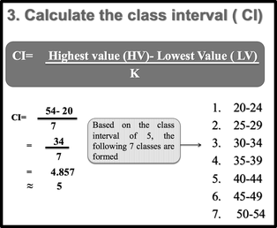

Slide 22
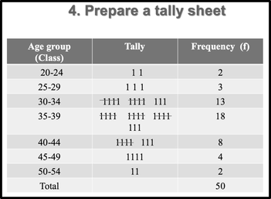

Slide 23
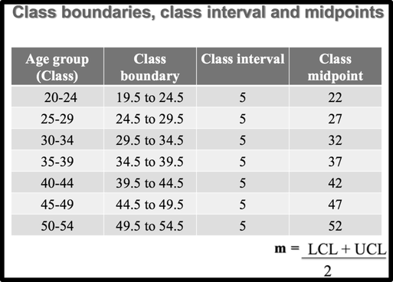

Slide 24
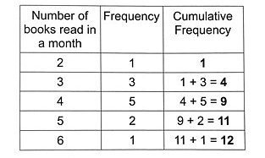
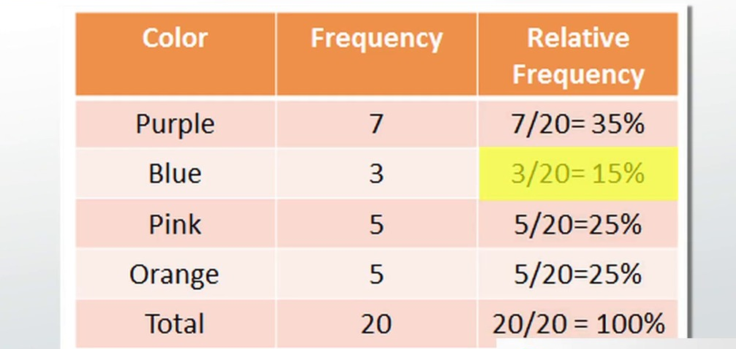
Cumulative Frequency
Cumulative frequency is the total of a frequency and all frequencies in a frequency distribution until a certain defined class interval.
Relative Frequency
Relative frequency is the number of times an event occurs divided by the ratio of the total event in that case.

Slide 25
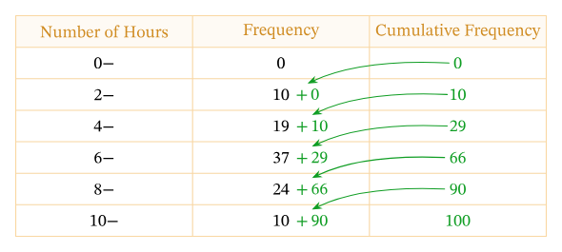
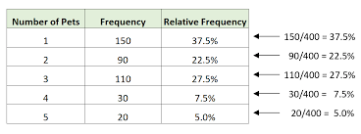
Cumulative Frequency

Slide 26

Stem and Leaf Display
An efficient way of organizing a small to moderate sized data set is to utilize a stem and leaf plot Such a plot is obtained by first dividing each data value into two parts its stem and its leaf. For instance, if the data are all two digit numbers, then we could let the stem part of a data value be its tens digit and let the leaf be its ones digit Thus, for instance, the value 62 is
$$Stem = 6$$
$$Leaf=2$$
expressed as and the two data values 62 and 67 can be represented as
$Stem = 6$
$Leaf=2$, 7

Slide 27
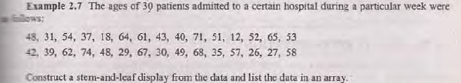
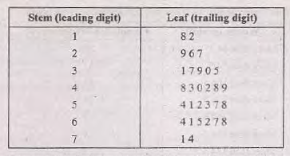
Stem and Leaf Display

Slide 28
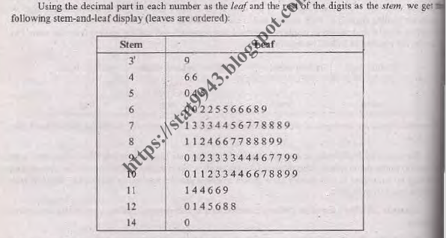
Stem and Leaf Display

Slide 29
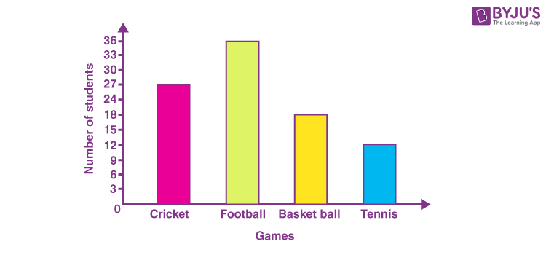
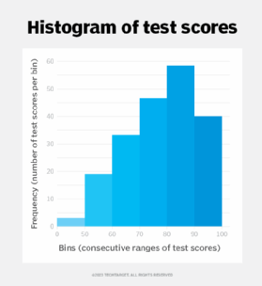
Graphical Representation
Histogram
A Histogram consist of set of adjacent rectangles whose bases are marked off as class boundaries ( not class limit) on the axis and whose heights are proportional to the frequencies associated with respective classes.

Slide 30
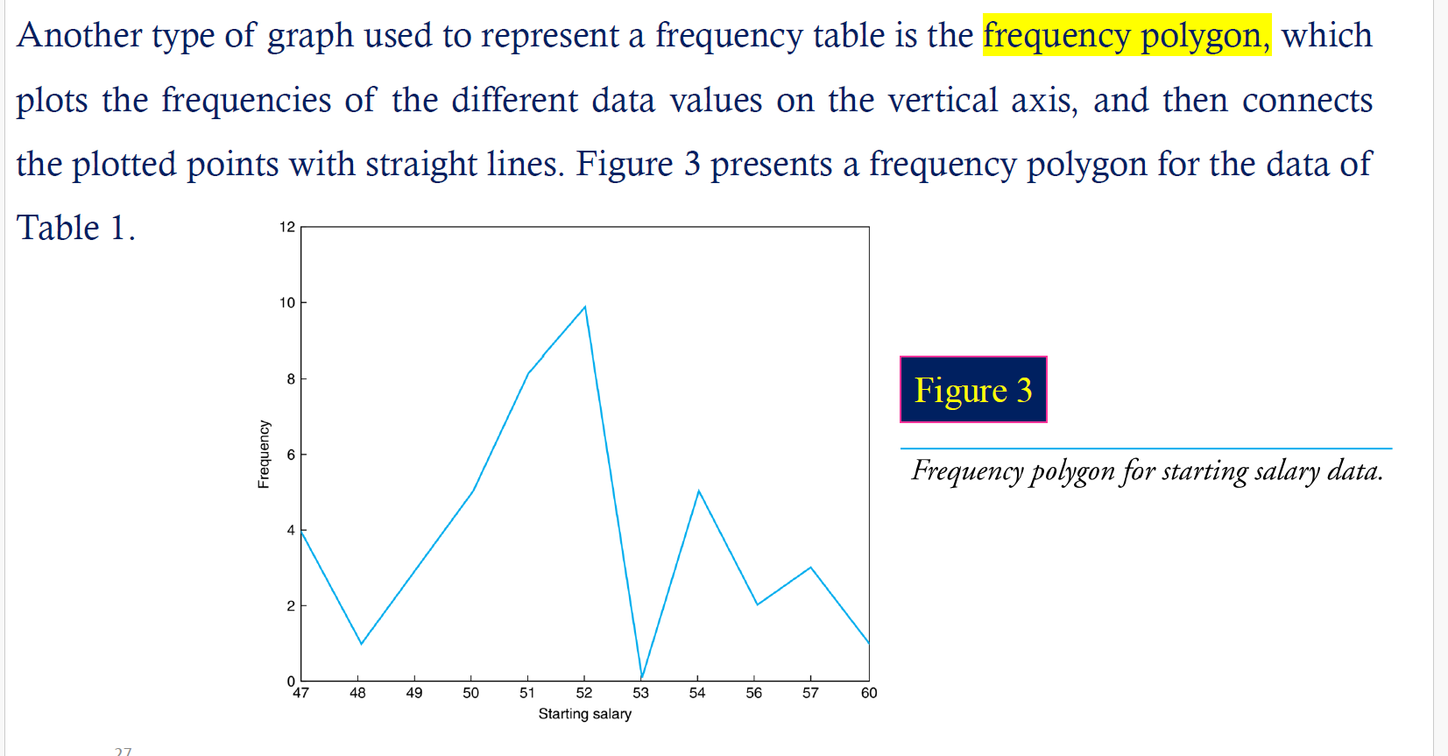
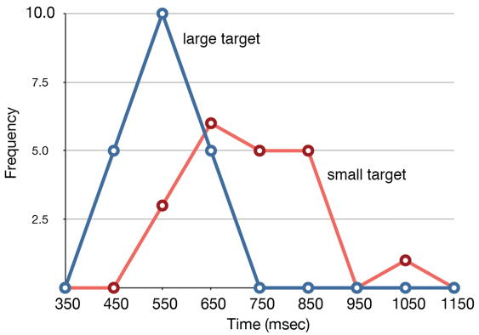
Frequency Polygon

Slide 31
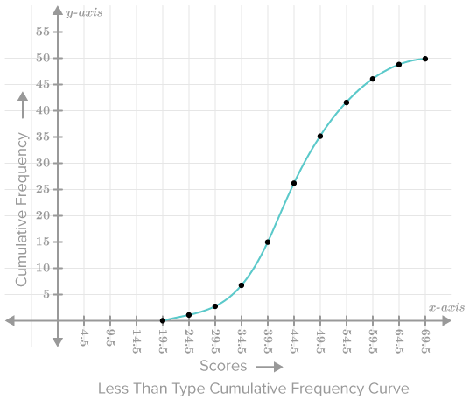
Cumulative Frequency Polygon
A cumulative frequency polygon is a line graph that shows the cumulative frequency distribution of a set of data.

Slide 32
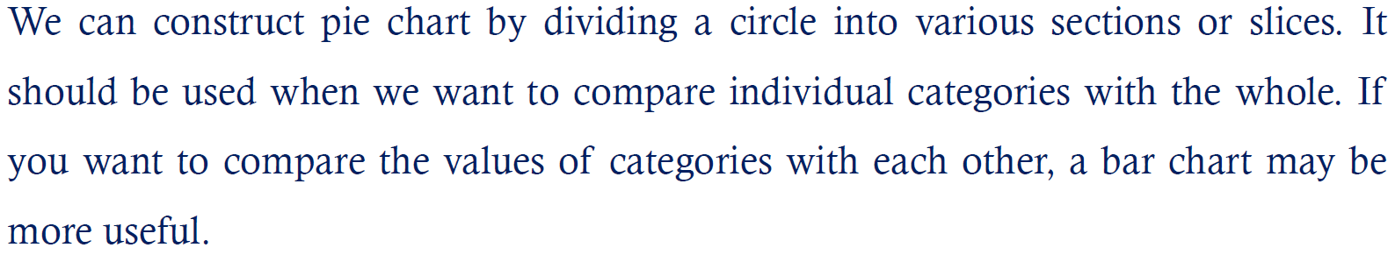
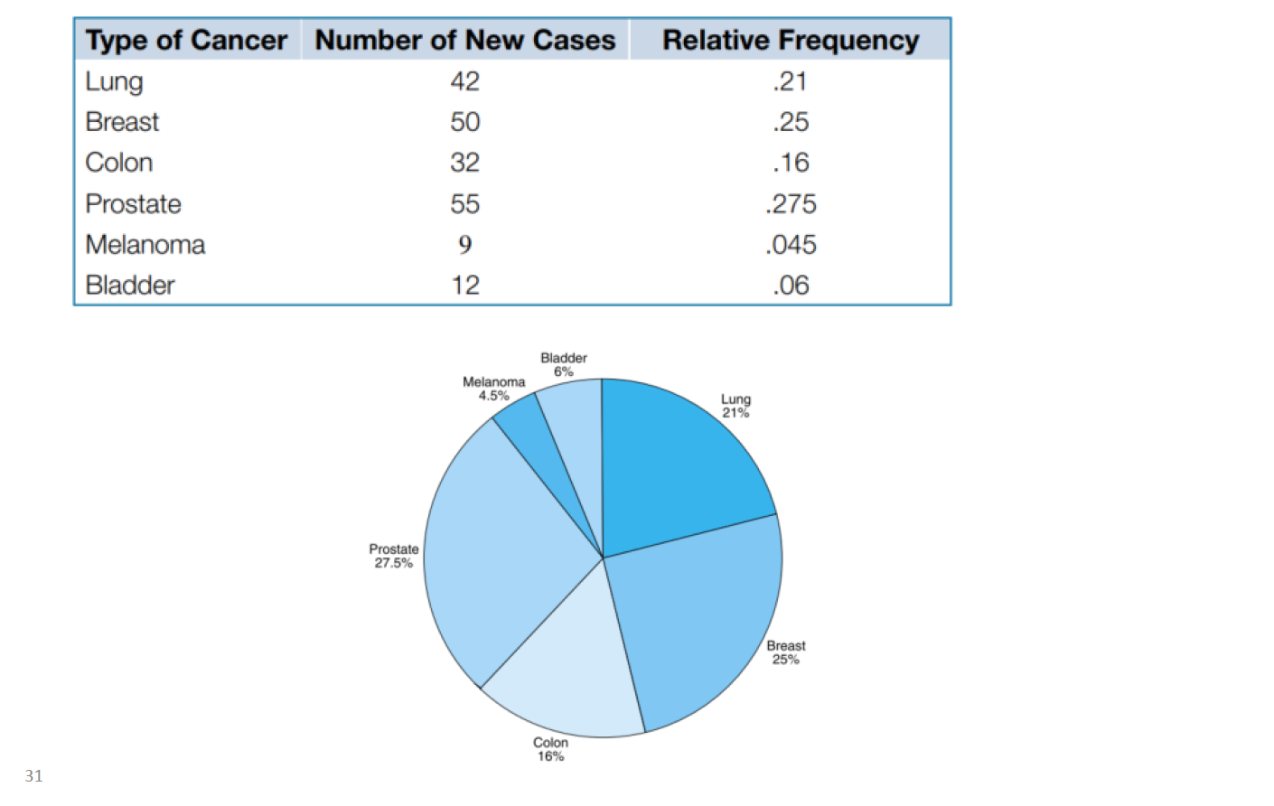
Pie Chart
.

Slide 33
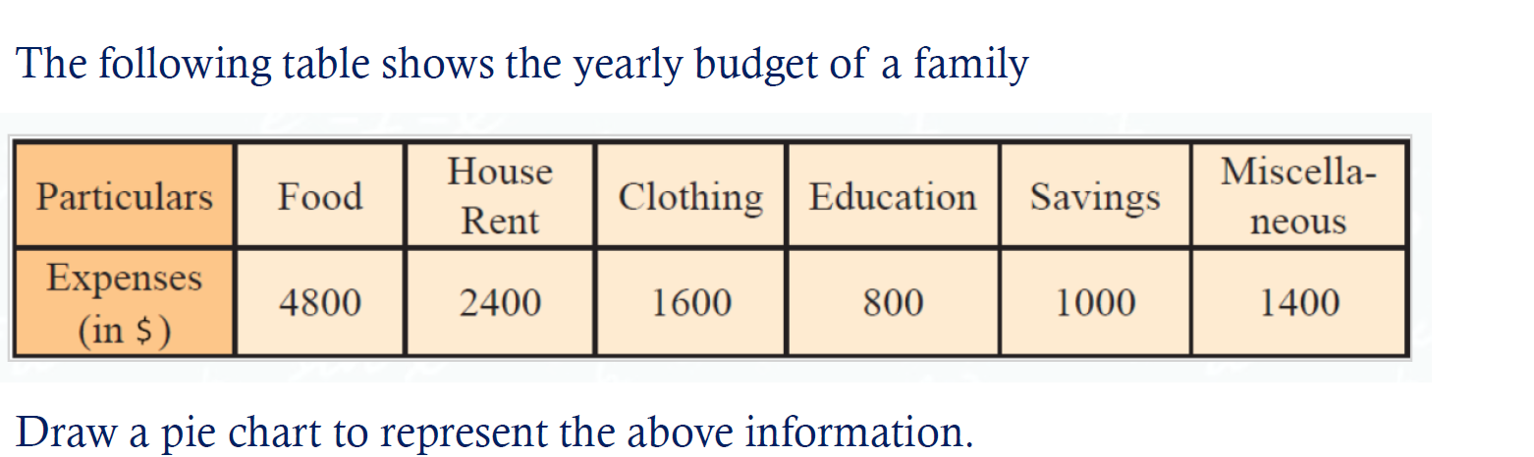
Pie Chart

Slide 34
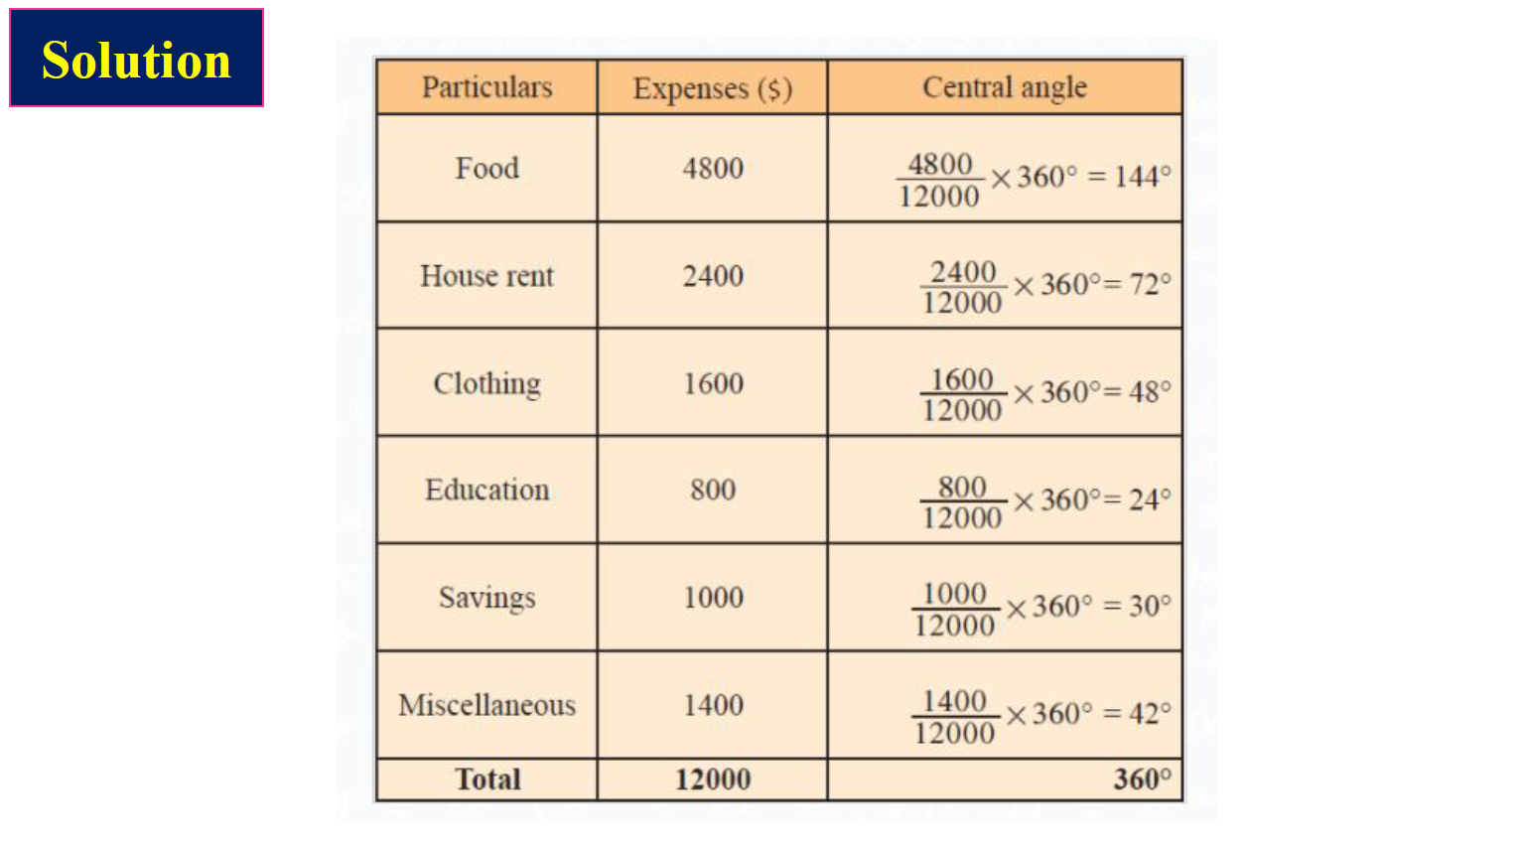
Pie Chart

Slide 35
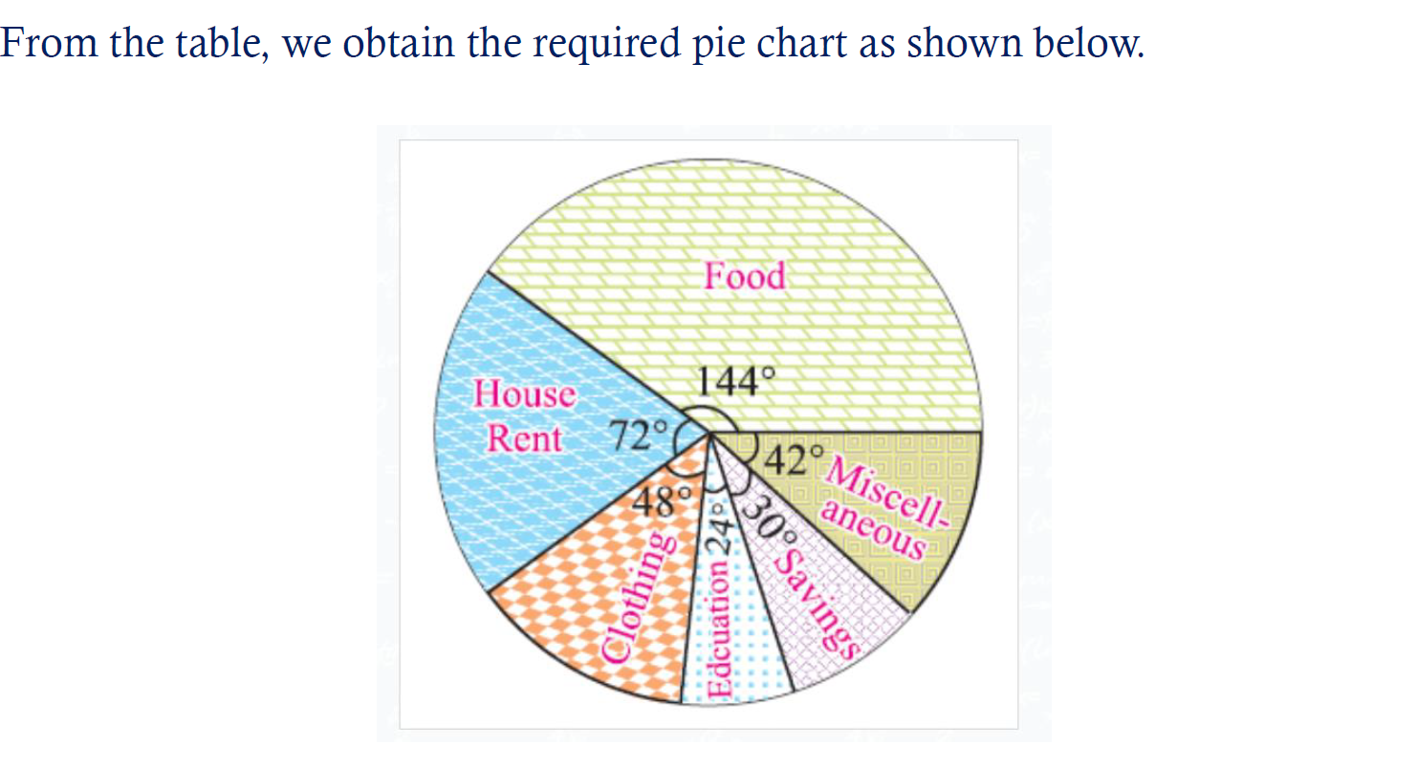
Pie Chart

Slide 36
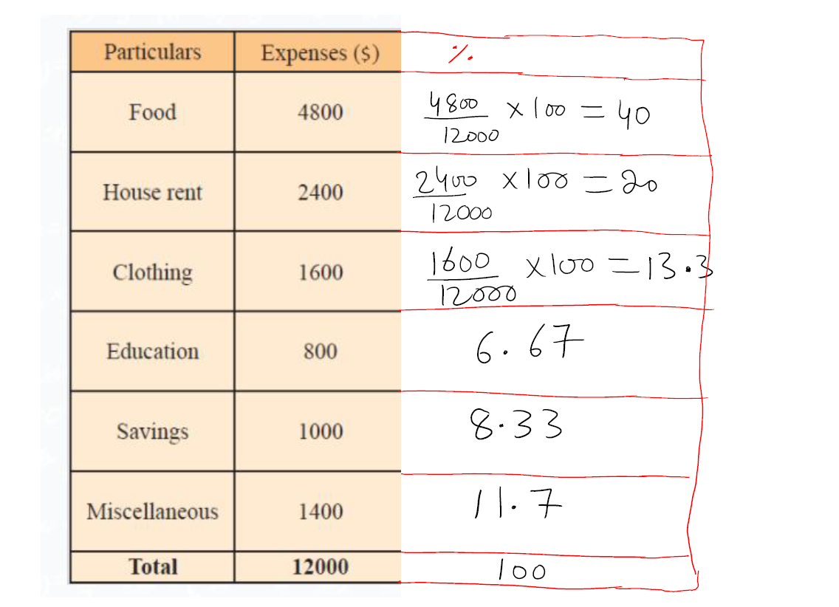

Slide 37
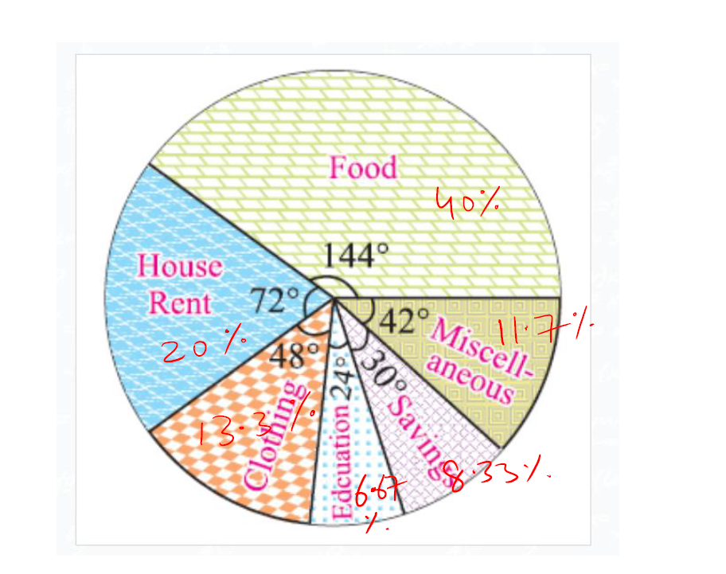

Slide 38
Mean for the Grouped data

Slide 39
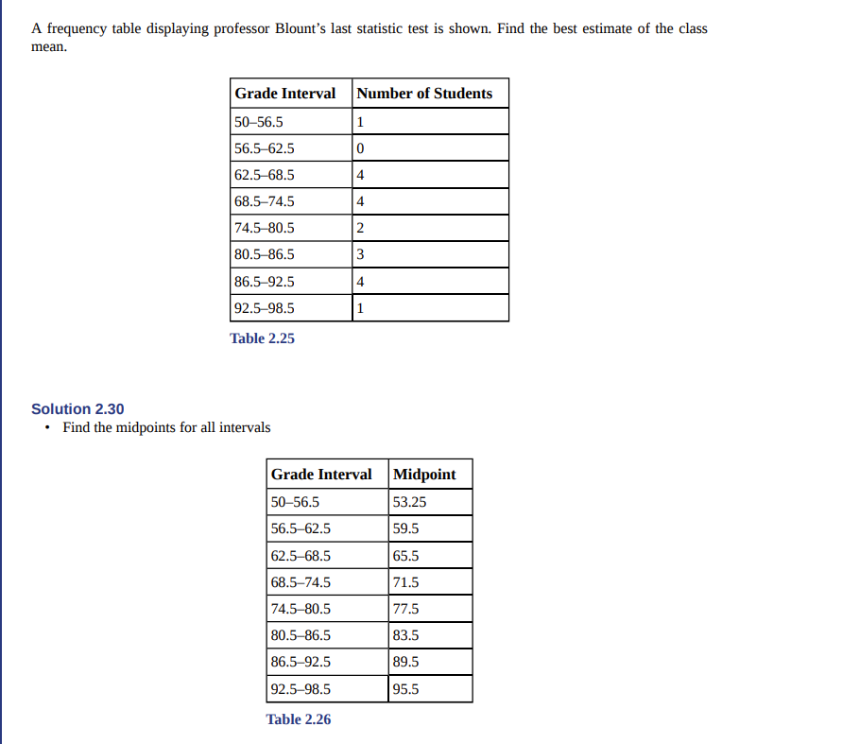

Slide 40
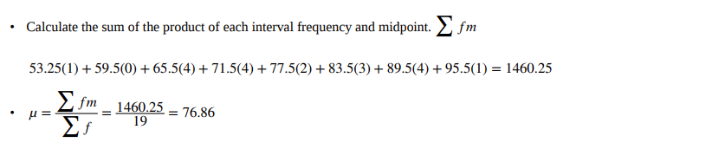
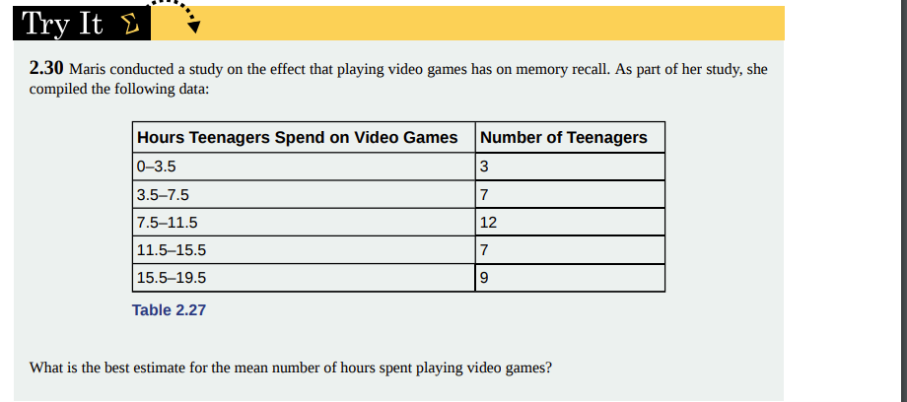
Mean for the Grouped data

Slide 41
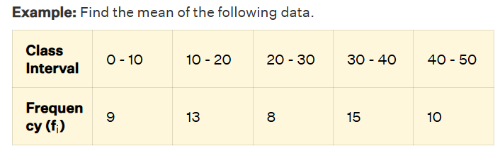
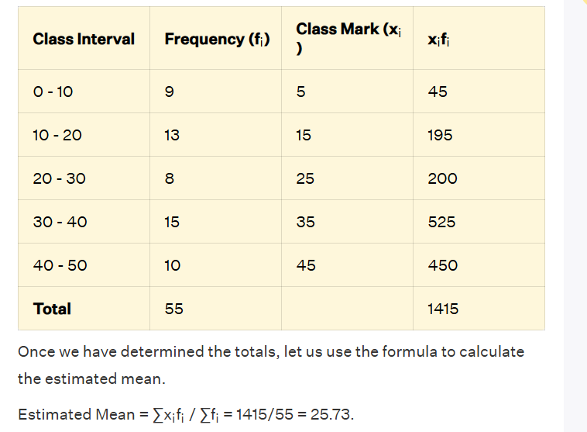

Slide 42
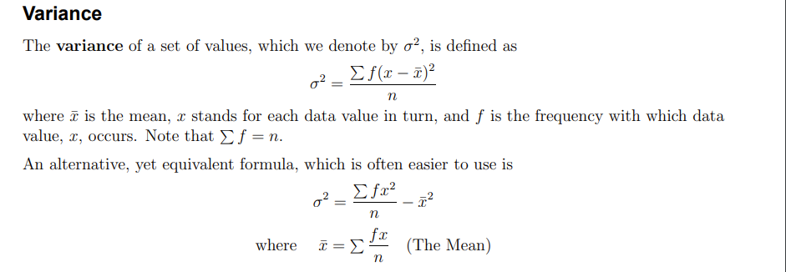

Slide 43
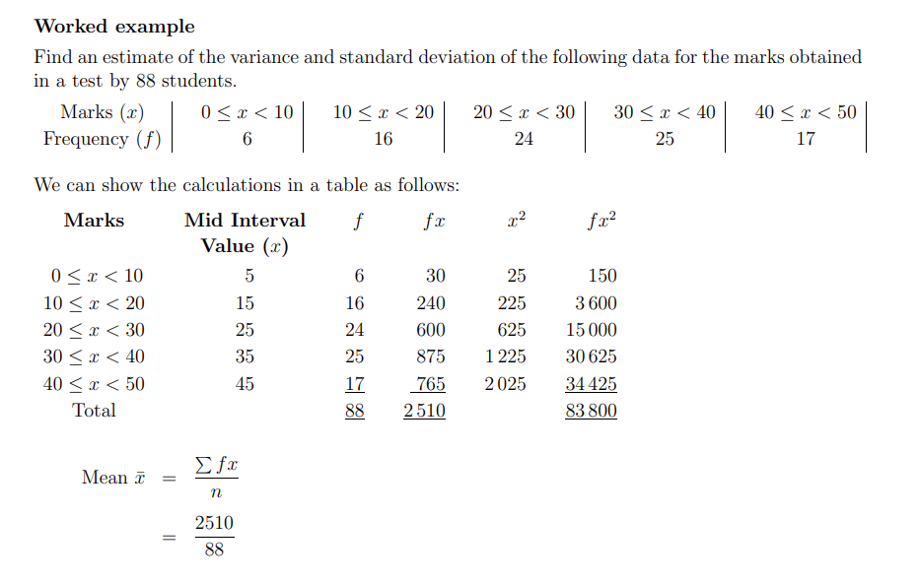

Slide 44
